Slide 1
Intro to Java
Vishal Yelisetti

Slide 2
Java Introduction
Java is a programming language created by James Gosling from Sun Microsystems (Sun) in 1991.
The target of Java is to write a program once and then run this program on multiple operating systems.
The first publicly available version of Java (Java 1.0) was released in 1995.
In 2006 Sun started to make Java available under the GNU General Public License (GPL). Oracle continues this project called OpenJDK.

Slide 3
Java Properties
Platform independent: Java programs use the Java virtual machine as abstraction and do not access the operating system directly. This makes Java programs highly portable.
Object-orientated programming language: Except the primitive data types, all elements in Java are objects.
Strongly-typed programming language: Java is strongly-typed, e.g., the types of the used variables must be pre-defined and conversion to other objects is relatively strict, e.g., must be done in most cases by the programmer.
Interpreted and compiled language: Java source code is transferred into the bytecode format which does not depend on the target platform. These bytecode instructions will be interpreted by the Java Virtual machine (JVM). The JVM contains a so called Hotspot-Compiler which translates performance critical bytecode instructions into native code instructions.
Automatic memory management: Java manages the memory allocation and de-allocation for creating new objects. The program does not have direct access to the memory. The so-called garbage collector automatically deletes objects to which no active pointer exists.

Slide 4
Current Java Version – Java 13
Java is defined by a specification and consists of a programming language, a compiler, core libraries and a runtime (Java virtual machine) The Java runtime allows software developers to write program code in other languages than the Java programming language which still runs on the Java virtual machine. The Java platform is usually associated with the Java virtual machine and the Java core libraries.

Slide 5
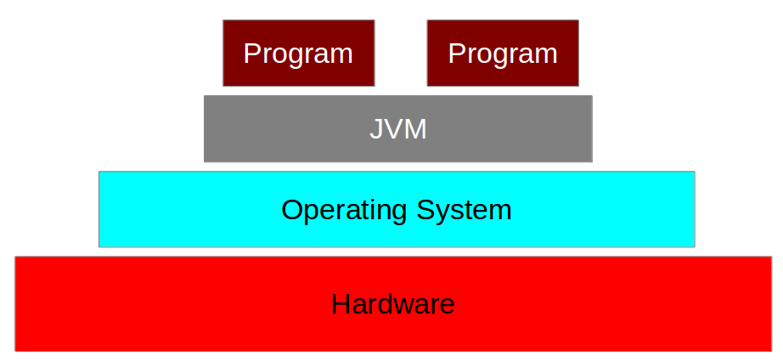
Java Virtual Machine

Slide 6
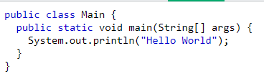
Java Syntax
Every line of code that runs in Java must be inside a class. In our example, we named the class Main. A class should always start with an uppercase first letter.
Any code inside the main() method will be executed. You don't have to understand the keywords before and after main.
Note: The curly braces {} marks the beginning and the end of a block of code.
Note: Each code statement must end with a semicolon.
Inside the main() method, we can use the println() method to print a line of text to the screen

